Slide 1

Public Consultation
September 23-October 14, 2023

Slide 2
Notetakers -
On your laptop …
Use wifi:
  SSID: Guest
  Password: AssumptionWireless98
Go to: https://frmoore.com/input/
  Download the notetaking sheet

Slide 3
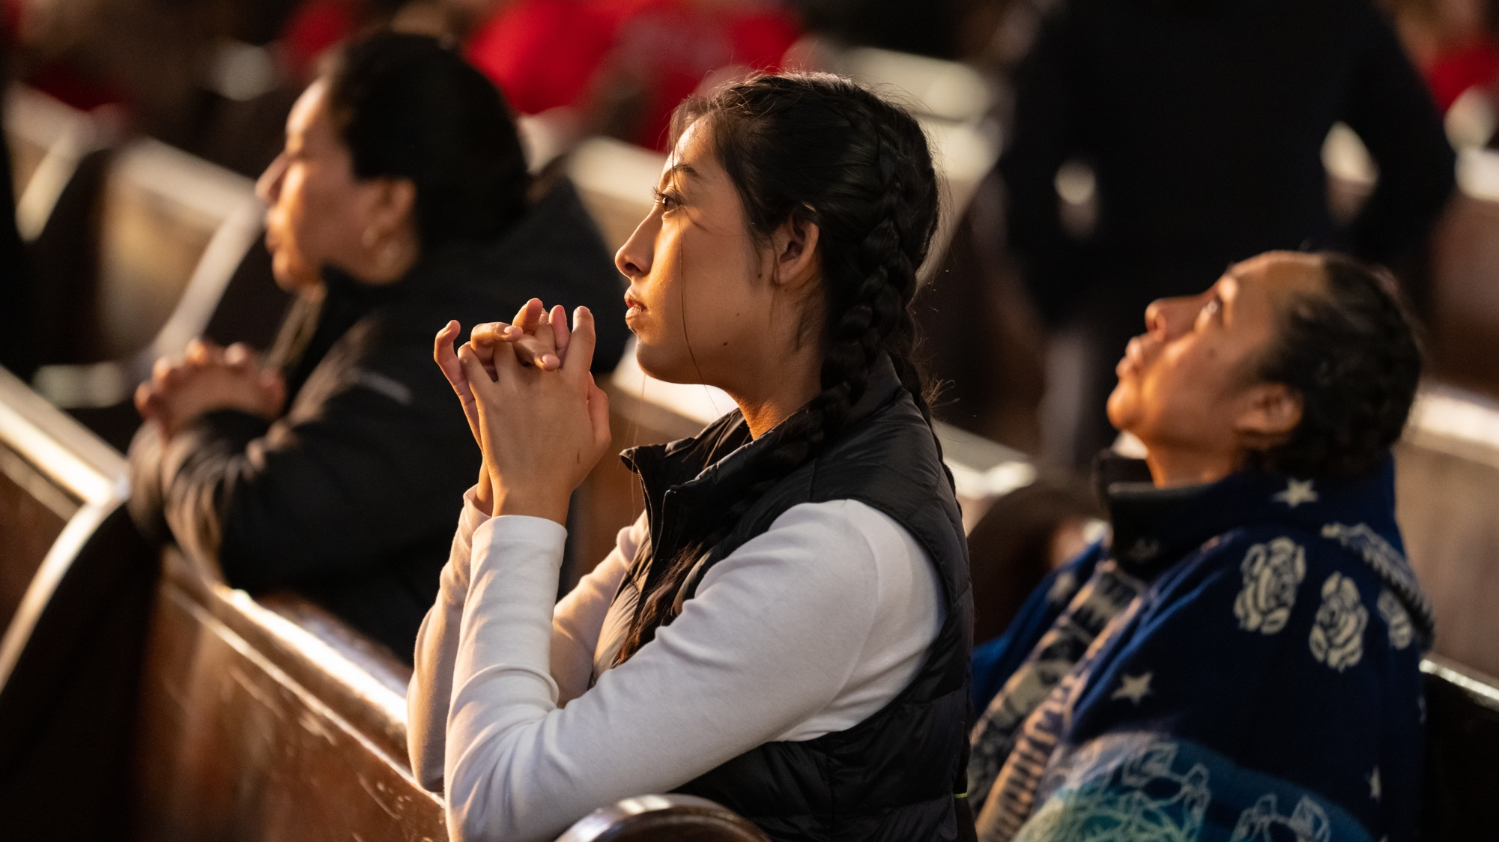
Let Us Pray
CLEANING SERVICES

Slide 4
Leader or Reader invites all to pray.
V. Come Holy Spirit, fill the hearts of your faithful,
R. And kindle in them the fire of your love.
V. Send forth your Spirit and they shall be created.
R. And You shall renew the face of the earth.
Let us pray.
O God, who by the light of the Holy Spirit,
did instruct the hearts of the faithful,
grant that by the same Holy Spirit
we may be truly wise
and ever enjoy His consolations,
Through Christ our Lord. Amen.

Slide 5
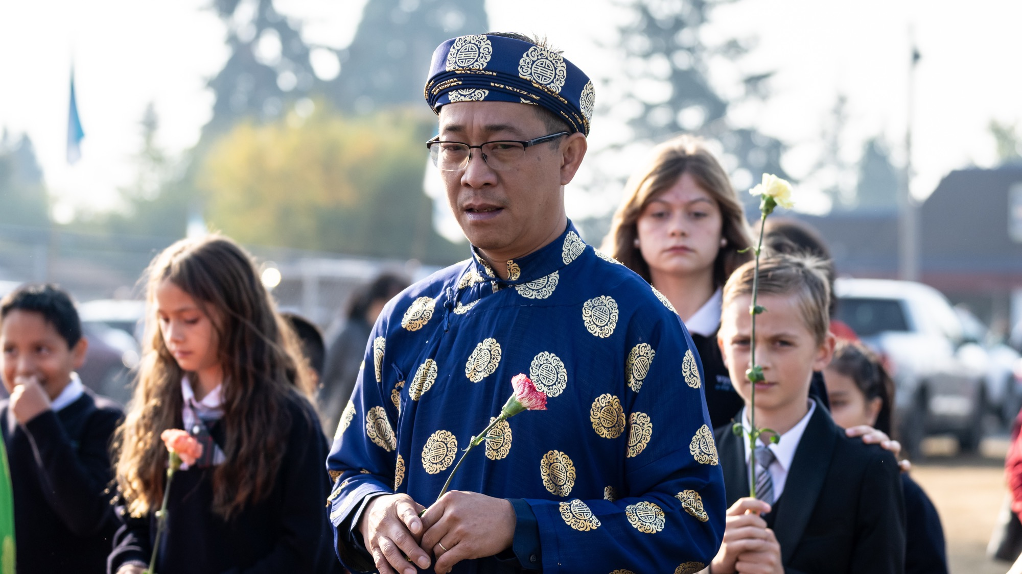
Today’s snapshot
CLEANING SERVICES
Notes:
Providing context, starting big with a wider picture & then narrowing our focus to Whatcom & Assumption

Slide 6
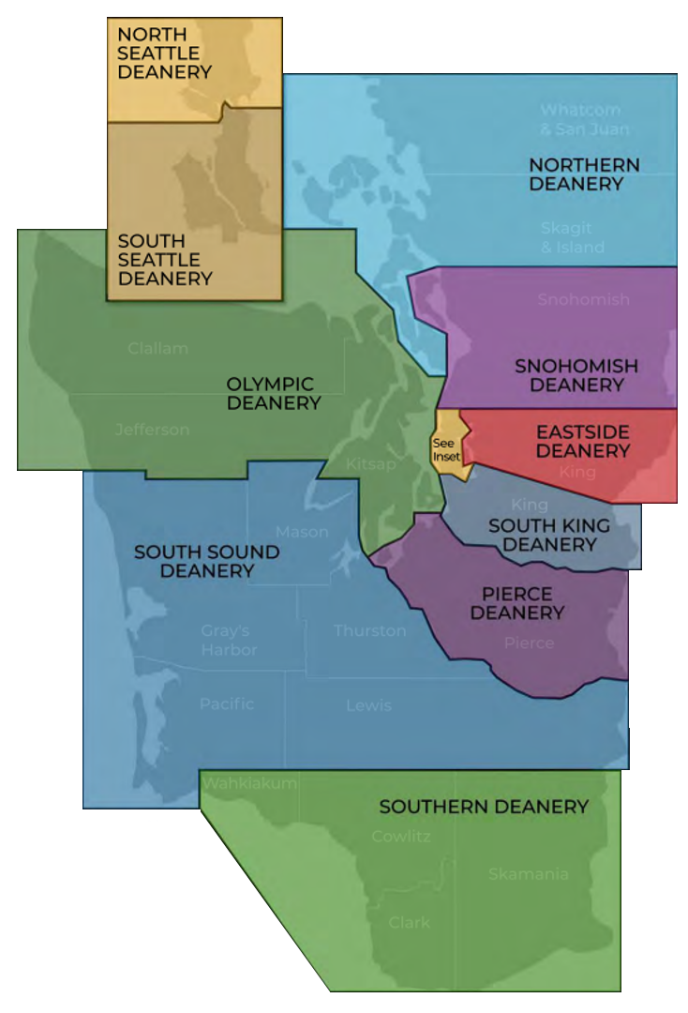
Archdiocese today
136
26
12
10
2
1
4
parishes
missions
stations
deaneries
camps
retreat center
Associated Catholic Cemeteries
Notes:
Where we’re at today as a diocese, Body of Christ in Western WA
Whatcom part of Northern Deanery

Slide 7
Long history in the Archdiocese of Seattle that points to our resilience.
Today, pastoral resources are declining, parish and pastor structures are not sustainable, and parishes are “living beyond their means,” while struggling to support staff, ministries and outreach.
Sadly, these factors affect the faith experience of parishioners.
Now we have the opportunity to change what we’re doing so we can restructure and re-envision parish life.
Reading the “signs of our time”
Notes:
We know there is a bit of a hard reality, and we are collectively trying to set ourselves up for success/sustainability, change is necessary for future success/sustainability, for hope
The way we have been doing things is not going to work anymore
Urgent & exciting opportunity to re-envision how we operate & transform parish life
We know things are hard, and we are trying to set ourselves up for success, change is necessary for future success
PRESENTER: THIS SLIDE IS SHOWS THAT WE HAVE CHANGED THROUGHOUT TIME AND WE HAVE A NEW CHANGE NOW
Today we face many realities that are impacting parish life and making it difficult to fully live out our mission. We face an urgent — yet exciting — opportunity to transform parish life.
Over the past few decades our local Catholic Church has experienced a decrease of engaged parishioners, fewer priests, dwindling finances, deteriorating campus conditions and more. Here are just a few statistics:
Today the archdiocese has 80 diocesan pastors for 174 locations; by 2036, we estimate we will only have 66 diocesan pastors, an 18% decrease. (We also have fewer seminarians and fewer lay ministry leaders.)
While the overall population the Archdiocese of Seattle is growing, registered households are declining, along with Mass attendance, baptisms, first communions, marriages in the Church and parish giving:
From 2010 to 2019, Mass attendance declined 11%.
Between 2010 and 2019, baptisms declined 32% and weddings declined nearly 19%.
Currently, 67% of parishes operate with a financial deficit (excluding extraordinary income, which is income from sources such as leasing properties and endowments).

Slide 8
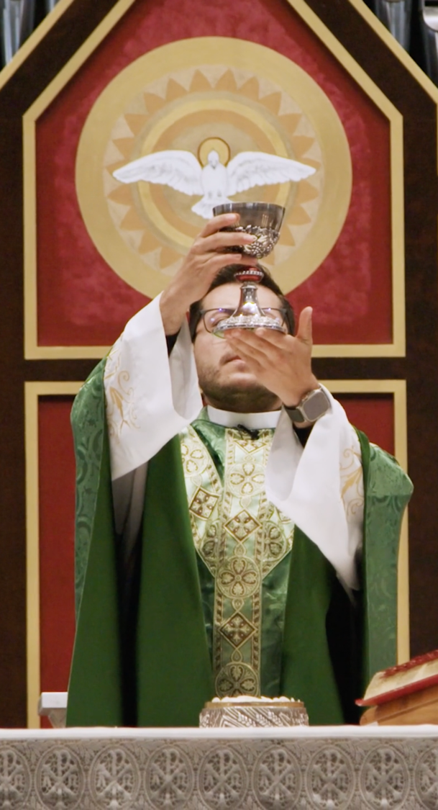
“We have a graced opportunity to reflect on what it truly means to be a community of missionary disciples.”
- Archbishop Etienne
“The status quo is no longer an option.”
-Archbishop Etienne
Notes:
THIS CHANGE IS FOCUSED ON HELPING PEOPLE KNOW JESUS

Slide 9
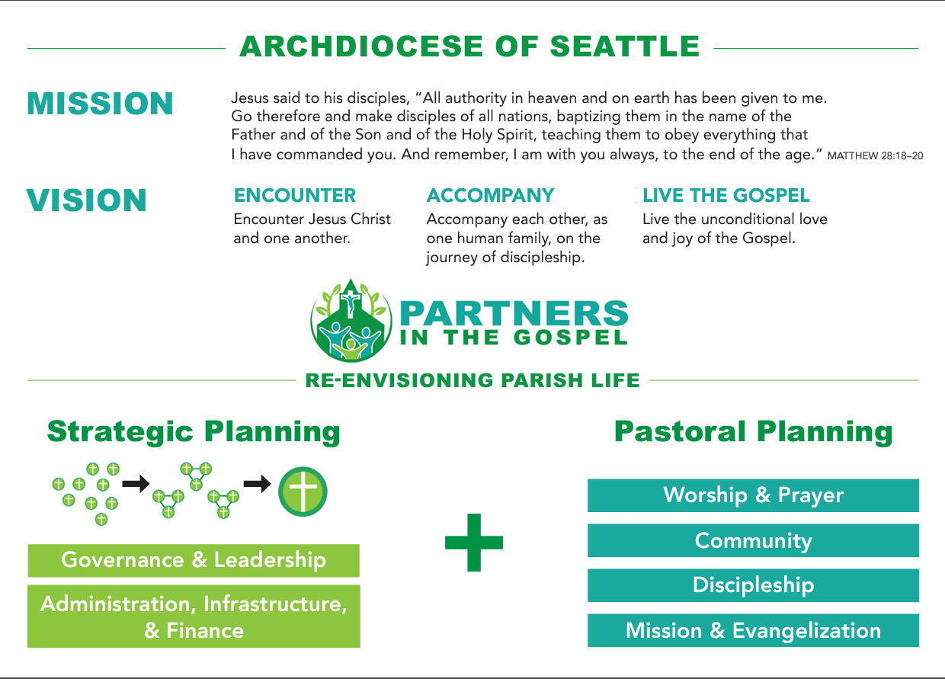
Notes:
Partners in the Gospel is a strategic pastoral planning process that is aligned with our mission as a church. At the top you see the Mission of the Church – and how we achieve the mission is through our Vision of ENCOUNTER, ACCOMPANY and LIVE THE JOY OF THE GOSPEL
Partners in the Gospel is 1 strategy to help us achieve our mission and vision.
We are doing this to help us better reach our vision!
Partners in the Gospel is how we re-invision parish life. We start with the restructuring so then we are in a better position to focus on re-envisioning parish life.

Slide 10
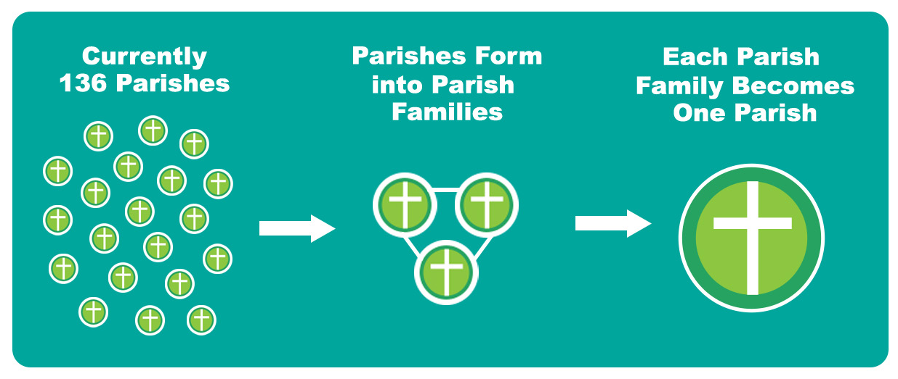

The journey to vibrancy
Notes:
Current: 136 Parishes (174 locations) into Draft 61 Parishes
Parish = administrative unit; Church = worship site
After consulting with many dioceses around the country and speaking with consultants, the Archdiocese determined that a parish family model would be best suited to our unique archdiocesan needs.
For this, each of our 136 parishes will be placed into a parish family under the leadership of one pastor.
Together the parish family will discern the best way to become one canonical parish over a period of about 3 years.

Slide 11

Timeline
Launch
Parish
families
form
Public
comment
Form
1 Parish
Parish
families
discern
& plan
Parish
families
announced
Consultation
Jan 2023
Spring/Summer
Fall 2023
Early 2024
July 2024
2024-2027
2027
Notes:
Where we’re at, where we’re going
This is the timeline for Partners in the Gospel.
It was first announced in January.
We’ve been undergoing multiple rounds of consultation with priests, parish/school staff and now we are in the Fall public comment period.
All the feedback will be shared for consideration by the Oversight Committee and Presbyteral Council for their recommendation to Archbishop Etienne.
Then next year, parish families will be announced in early 2024 with the actual formation of them in July 2024.
Then over 3 years the parishes will work together to become 1 parish.
Right now we are in the public comment period.

Slide 12
Parishes will join under one structure – called a parish family – with one pastor and one or more parochial vicars.
Most priests will move in this process, which mean most people will have a new pastor.
As of July 1, 2024, changes to staff structure, building use, etc. are unlikely to occur. These changes will be discerned over the next three years at the local level.
No churches will close as of July 1, 2024. Parish families may decide to close one or more churches after ongoing local discernment.
Things to keep in mind:
becoming a parish family
Notes:
Again, this is a slow process of working together to discern what makes sense for that parish family. READ THE BULLETS

Slide 13
The one canonical parish refers to the community of people and not the building designated for divine worship – the church.
Churches will retain their current names, but the one canonical parish itself will receive a new name.
Mass and other liturgical celebrations can happen at more than one parish church.
The one canonical parish will not be required to centralize operations at one location, but many may choose to.
Things to keep in mind:
becoming one canonical parish
Notes:
READ BULLETS

Slide 14
The pastor assigned in July 2024 will be the leader of the schools in the parish family.
Schools will not be required to change their names to match the one canonical parish – though some may choose to.
The community may decide to change how schools are structured by maintaining, repurposing, or consolidating locations.
All decisions that impact parish schools will be discerned at the local parish family level with the assistance of the Office for Catholic Schools.
Things to keep in mind:
schools in parish families
Notes:
READ BULLETS

Slide 15
This effort gives us the exciting and unique opportunity to change what we’re doing.
Imagine vibrant parishes with full Masses, active youth groups, hospitality that welcomes those who have fallen away, outreach efforts that engage those on the margins – and much more.
All of this is possible.
Parishes exist to ignite our faith and help us share the love of Jesus Christ with everyone – even those outside our parish.
Don’t lose sight of
the WHY
Notes:
A lot of hope, opportunities – personally excited!
People can get caught in all the details and stress about the unknown. We must not forget WHY we are doing this and the great possibilities and opportunities it presents.

Slide 16
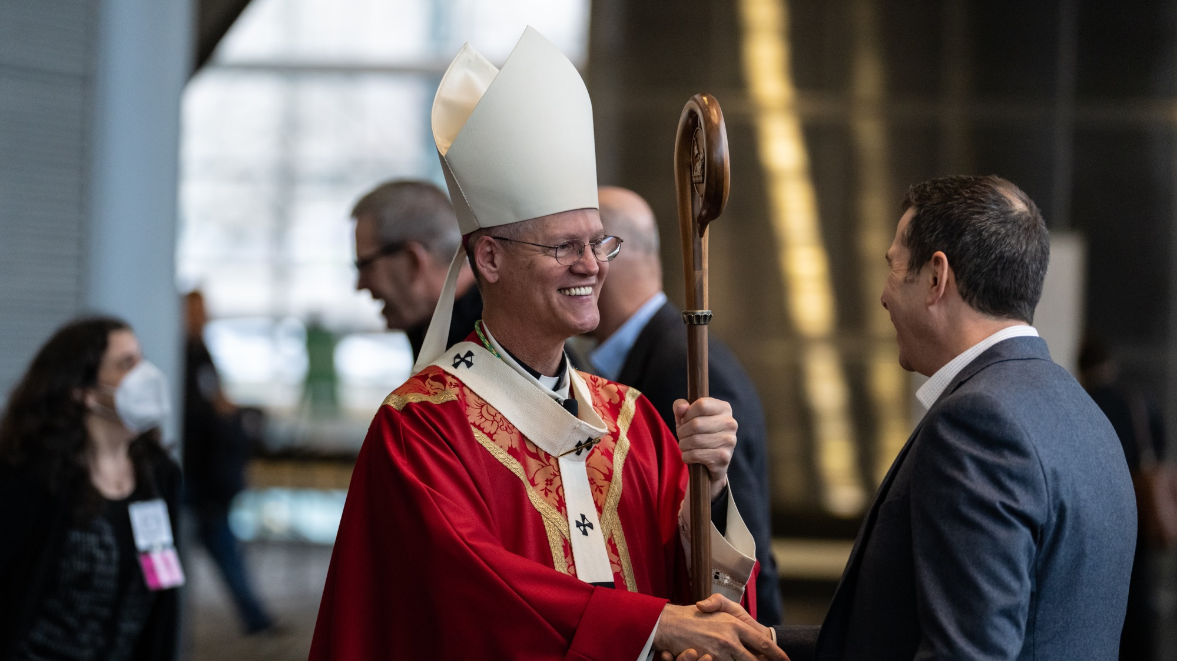
Today we are here to listen to you
CLEANING SERVICES

Slide 17
Understanding Draft Parish Families Development
Initial drafts were created with the assistance of the Catholic consulting firm PartnersEdge before being reviewed, updated, and approved by Oversight Committee and the Presbyteral Council.
Notes:
First lets understand what we are providing feedback on: The drafted parish families.

Slide 18
Understanding Draft Parish Families Development
Multiple drafts were developed by the Oversight Committee and Presbyteral Council after successive rounds of consultation with a consulting firm, chancery staff, and priests.
You are seeing draft 4 today, and it is now time to give input for the final draft.

Slide 19
Our Drafted Parish Family
Option #1 – Draft Proposal
Family #2 | Family #3
Church of the Assumption, Bellingham Sacred Heart, Bellingham Viking Catholic @ WWU, Bellingham | St. Anne, Blaine St. Joachim, Lummi St. Joseph, Ferndale St. Joseph, Lynden St. Peter, Deming

Slide 20
Another Viable Option
Share your thoughts on this in round 3 of input:
Family #2 | Family #3
Church of the Assumption, Bellingham Sacred Heart, Bellingham St. Peter, Deming Viking Catholic @ WWU, Bellingham | St. Anne, Blaine St. Joachim, Lummi St. Joseph, Ferndale St. Joseph, Lynden ←(St. Peter, Deming)

Slide 21
Another Viable Option
Share your thoughts on this in round 3 of input:
(with 1 Pastor & ~3 Parochial Vicars)
Family #2
Church of the Assumption, Bellingham Sacred Heart, Bellingham St. Anne, Blaine St. Joachim, Lummi St. Joseph, Ferndale St. Joseph, Lynden St. Peter, Deming Viking Catholic @ WWU, Bellingham

Slide 22
Listening to you
Your voice is important.
We will break into small groups for our input on the drafted parish families.
Each will have a notetaker who will capture the conversation.
These notes will be sent into the Chancery to be processed. Pastoral Council will also review all input.
Notes:
These are the 3 questions we will be covering in today’s session.

Slide 23
What will happen with the feedback?
All feedback will be read by at least two people (at the Chancery level).
A synthesis will be created for each draft family, to capture general and specific suggestions/comments for the Oversight Committee, Presbyteral Council, and Archbishop Etienne as the final draft of the parish families is prepared.
There will be an online submission form at www.archseattle.org/partners if you have more to share (or if you know people who couldn’t join us.)

Slide 24
Approach for today’s
input session
CLEANING SERVICES

Slide 25
Goal: Understand others as they are
Listening is a profound welcome of the other person in his or her radical uniqueness.
This intentional welcome is rooted in an expectation that the Holy Spirit is present when we are speaking to each other.
When you are not speaking, active listening is your main role.
Active listening is demanding. It requires humility, openness, patience, and involvement.
It means listening to the other now as he or she is speaking, and not concentrating on what one will say next.
Spiritual Conversations
Active listening is the foundation of prayerful listening

Slide 26
Guidelines for Prayerful Listening
Listen generously without needing to respond.
Please refrain from cross talk and/or judgment.
Share from your own experience.
Be mindful of the amount of time we speak.
Diversity in perspectives and backgrounds is a gift.
Honor confidentiality: “what’s said stays,” and “what’s learned goes.”
Everyone has something valuable to offer.
Continue to share even if someone else has already shared this idea, this is because even though the thoughts are the same, each person communicates differently.

Slide 27

Each person has equal time to share.
After everyone shares, there is no conversation or response. Sit in silence for a moment, then the next person shares (this also gives time to the notetaker).
After Round One, each person shares 1 thing that is resonating for them - one sentence, or even one word.
The second round of listening follows the same pattern.
The small group gathering ends with time for free conversation and back-and-forth.
An hour is provided for small group listening, then prayer with large group.
Please note, the facilitator may provide additional information or clarify a misunderstanding at the end of each round.
A Synodal Model of Listening and Consultation

Slide 28
Key Questions
What concerns do I have about the proposed family grouping? What challenges might this pose?
What hopes do I see in the proposed family grouping? What opportunities or possibilities might this offer?
What additional thoughts and feedback (including proposed changes to the parish family) do I have?
Notes:
These are the 3 questions we will be covering in today’s session.

Slide 29
Small group listening and discussion
Preparation
Spend 5 minutes in silence reflecting on the question before sharing.
Sharing
Each person shares thoughts on question (about 2 minutes per person - facilitator will set a timer on their phone).
  Reminder: there is no conversation or response
Summing Up
In 1-2 words or sentences, what did I hear from others?
Notes:
RIGHT NOW IS WHEN WE TURN TO SMALL GROUPS
We will start with silence and then move on to sharing.

Slide 30
Questions?

Slide 31
What concerns do I have about the proposed family grouping? What challenges might this pose?
CLEANING SERVICES
Notes:
KEEP THIS SLIDE ON THE SCREEN DURING THIS PORTION
Preparation
Spend 5 minutes in silence reflecting on the question before sharing.
Sharing
Each person shares thoughts on question.
Summing Up
In one-two sentences, what did I hear from others?

Slide 32
What hopes do I see in the proposed family grouping? What opportunities or possibilities might this offer?
CLEANING SERVICES
Notes:
THEN MOVE ON TO THIS QUESTIONS WHEN GROUPS BEGIN TO MOVE FORWARD
Preparation
Spend 5 minutes in silence reflecting on the question before sharing.
Sharing
Each person shares thoughts on question.
Summing Up
In one-two sentences, what did I hear from others?

Slide 33
What additional thoughts and feedback (including proposed changes to the parish family) do I have?
CLEANING SERVICES
Notes:
THEN MOVE TO THIS SCREEN WHEN GROUPS BEGIN
Preparation
Spend 5 minutes in silence reflecting on the question before sharing.
Sharing
Each person shares thoughts on question.
Summing Up
In one-two sentences, what did I hear from others?

Slide 34
Free Conversation
(10 min)
CLEANING SERVICES
Notes:
KEEP THIS SLIDE ON THE SCREEN DURING THIS PORTION
Please spend the last few minutes for free conversation.
What additional thoughts and feedback (including proposed changes to the parish family) do I have?

Slide 35
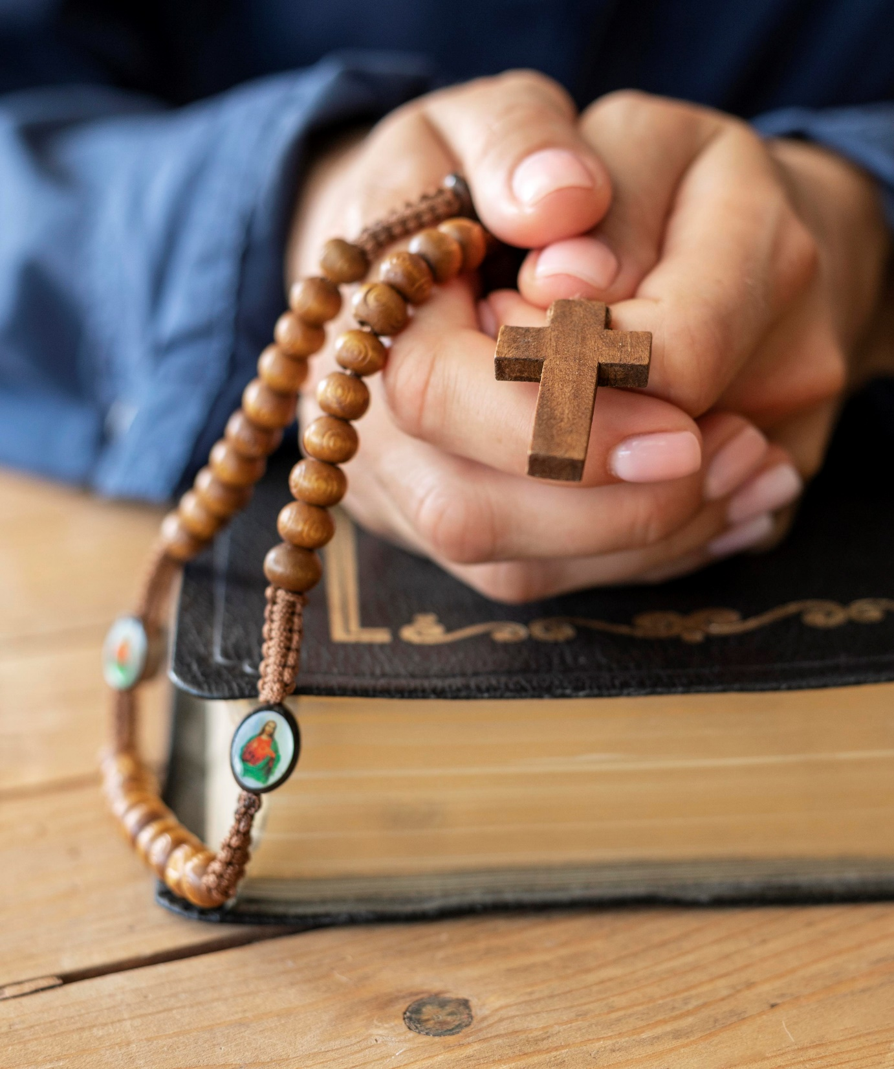
Together
The focus is creative re-envisioning to help people know Jesus Christ.
We need you on this journey.
Listen to the Holy Spirit.
Pray for this effort.
Engage in the process.
Provide your input.
Together we can renew our
local Church.

Slide 36
THANK YOU!

